Slide 1

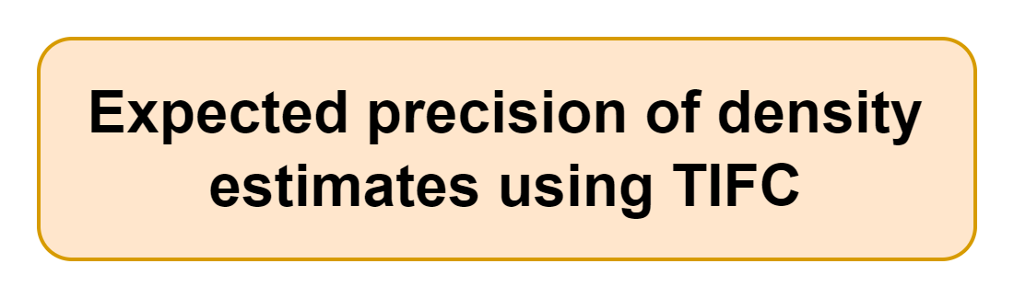

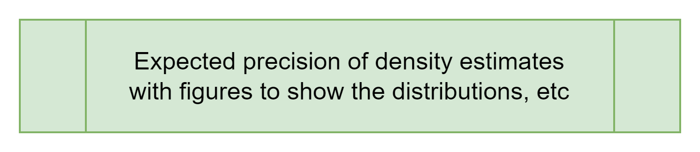
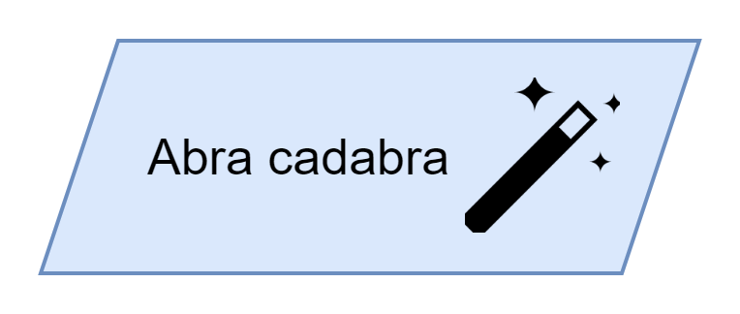
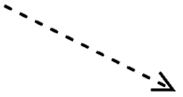

TIFC app inputs
Number of cameras
Length of deployment (days)
Lure (yes/no)
Species of interest (or maybe rare/medium/common)
Number of treatments of interest

Slide 2
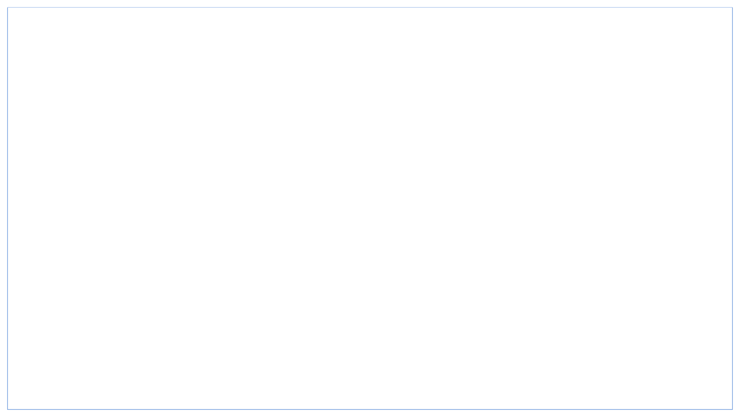
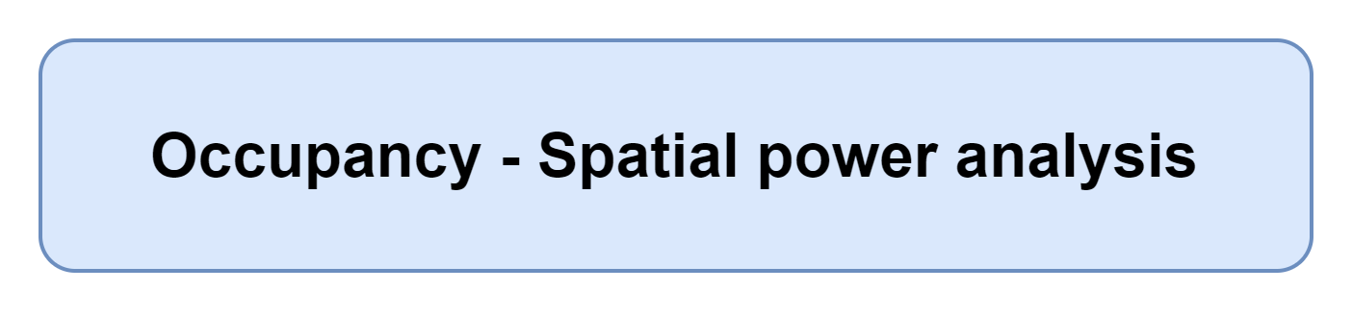
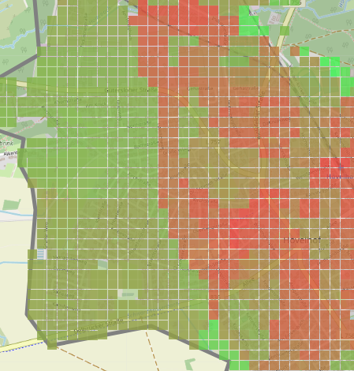

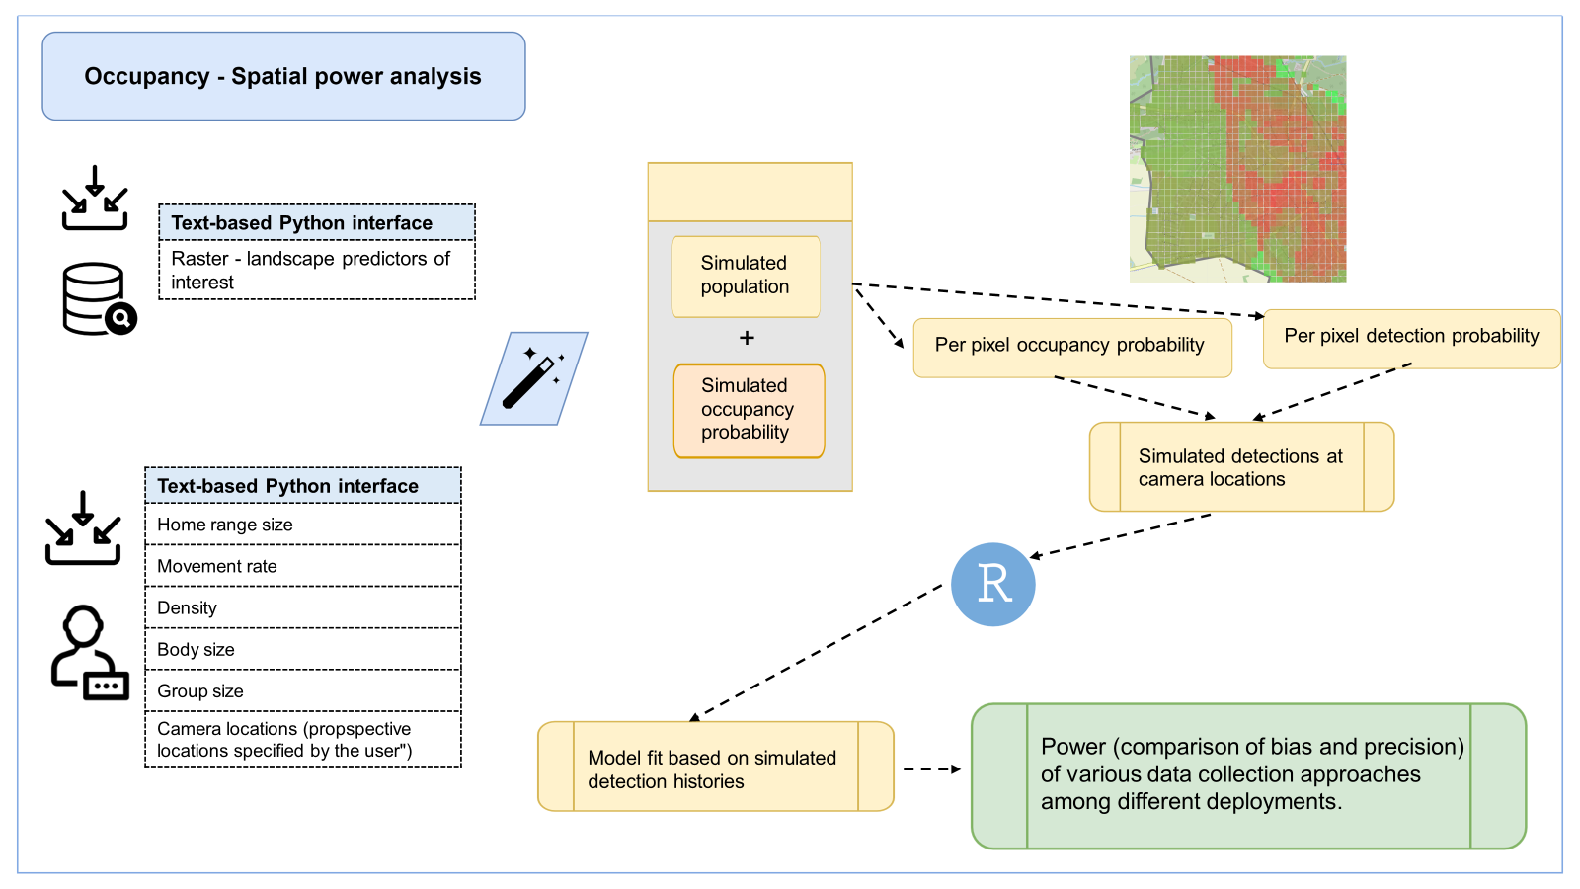
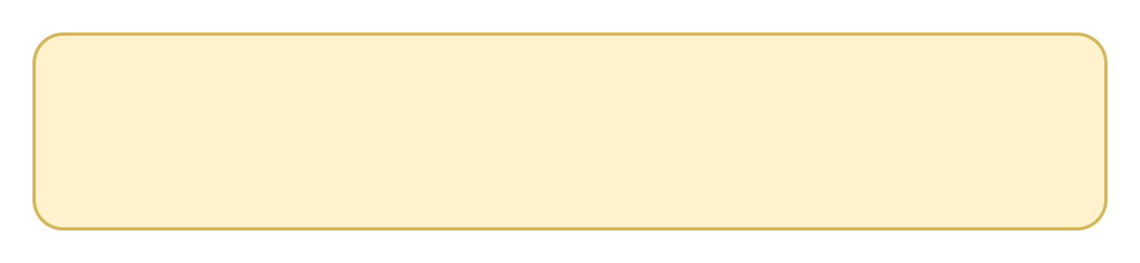


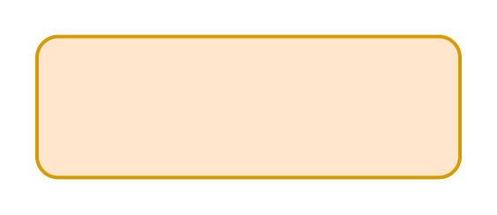
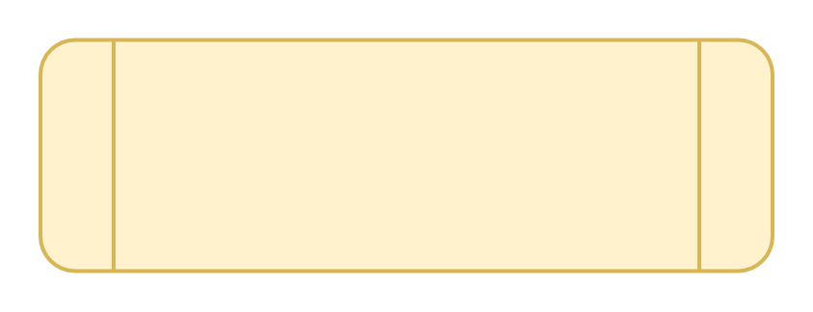

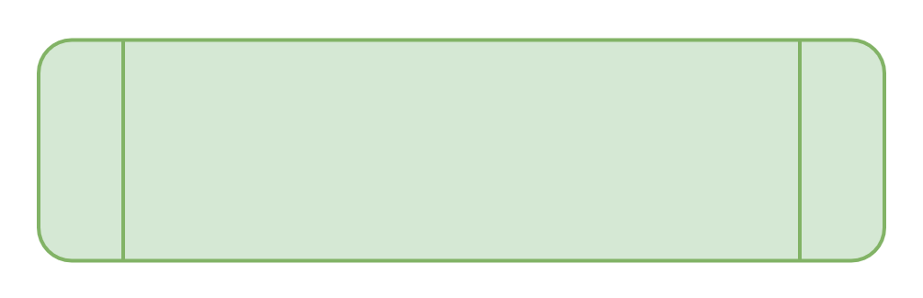
Text-based Python interface
Raster - landscape predictors of interest
Simulated population
+
Per pixel occupancy probability
Per pixel detection probability
Simulated occupancy probability
Simulated detections at camera locations
Text-based Python interface
Home range size
Movement rate
Density
Body size
Group size
Camera locations (propspective locations specified by the user")
Model fit based on simulated detection histories
Power (comparison of bias and precision) of various data collection approaches among different deployments.

Slide 3

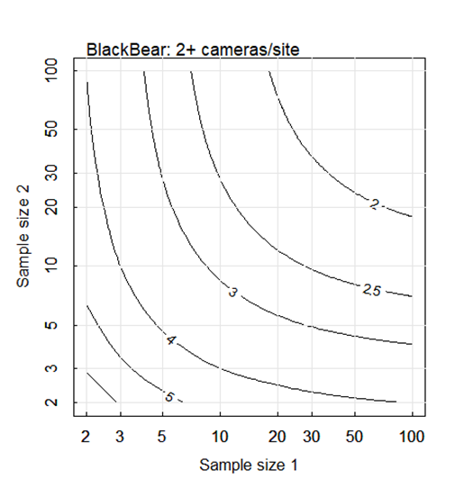
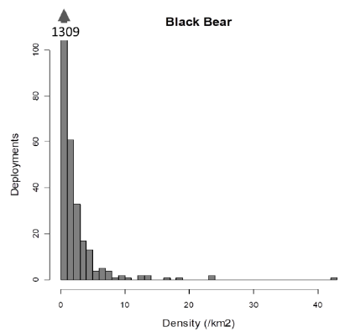
Monte Carlo simulation (10,000 runs) to evaluate expected precision of density estimates
Shiny app outputs
Shiny app user-inputs
Number of cameras
Length of deployment (days)
Lure (yes/no)
Rare/medium/common (with examples) species of interest
Number of treatments of interest
Game trail vs random deployment
Figure of distribution of simulated animal densities (bar chart)
Expected precision of design based on inputs
Figures of expected precision given the number of treatments and cameras

Slide 4
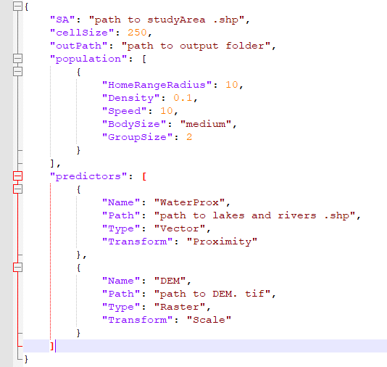
Text-based Python interface
Landscape Drivers of Use (.shp/.tif)
Home range centers
Text-based Python interface
Home range size (radius (m))
Movement rate (m/s)
Density (count/m2)
Body size (small/medium/large)
Group size (count)

Slide 5

Simulate agents moving
Fit occupancy model based on simulated detection histories
Text-based Python interface
Landscape Drivers of Use (.shp/.tif)
Home range centers
Simulated detection history at camera locations
Text-based Python interface
Home range size (radius (m))
Movement rate (m/s)
Density (count/m2)
Body size (small/medium/large)
Group size (count)
Estimate bias (compared to ‘real’ occupancy and detectability) and precision of various data collection approaches among different deployments.
Simulate ’real’ probability of occupancy and detection across landscape

Slide 6
Simulate agents moving
Fit occupancy model based on simulated detection histories
Text-based Python interface
Landscape Drivers of Use (.shp/.tif)
Home range centers
Simulated detection history at camera locations
- Movement rate informed by body size + diet vs ungulate (+ others). Build out use cases after that. 2-3 buckets of speed ---
Text-based Python interface
Home range size (radius (m))
Movement rate (m/s)
Density (count/m2)
Body size (small/medium/large)
Group size (count)
Estimate bias (compared to ‘real’ occupancy and detectability) and precision of various data collection approaches among different deployments.
Simulate ’real’ probability of occupancy and detection across landscape

Slide 7
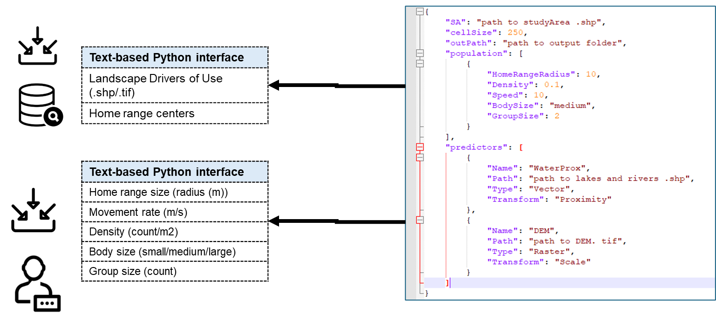
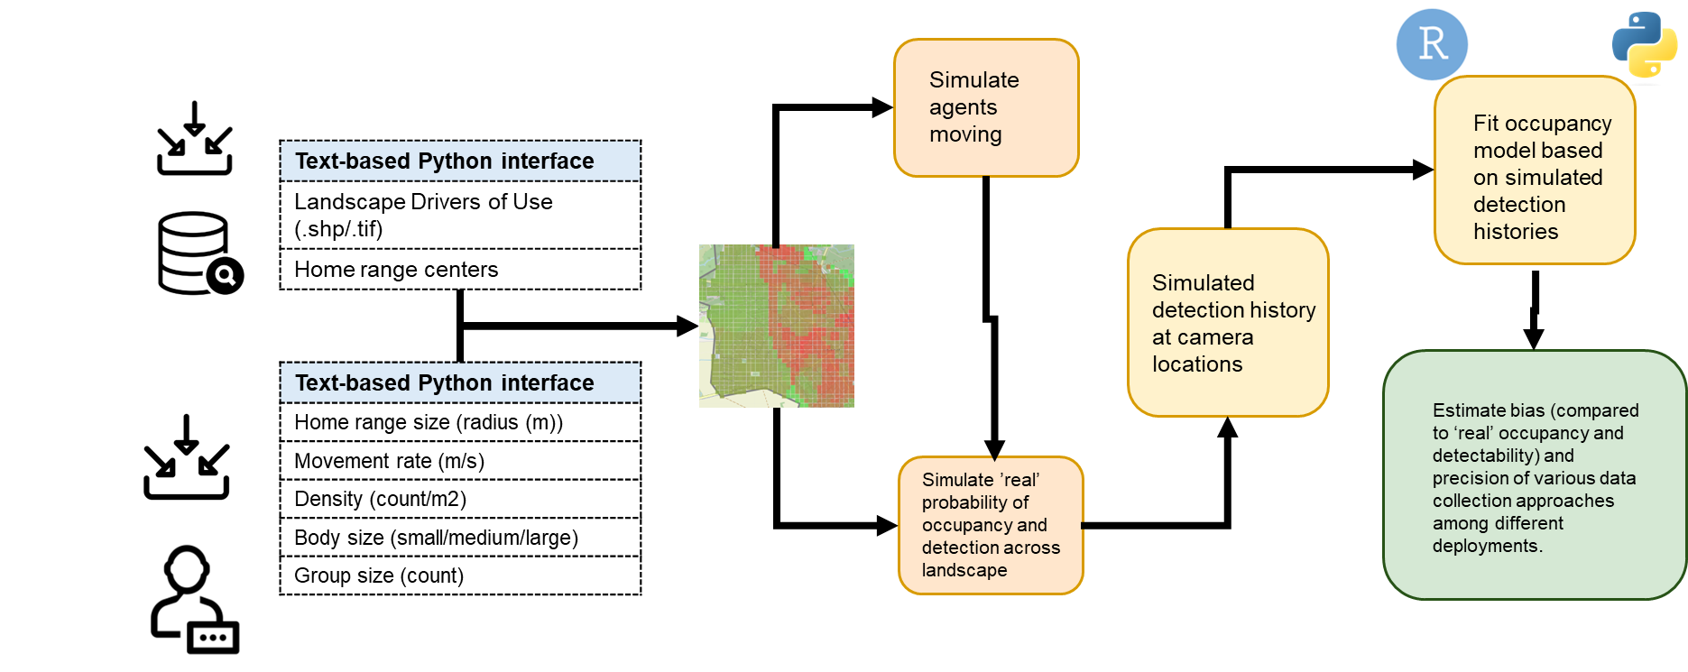

Slide 8











Slide 9


Alberta Environment and Protected Areas & Office of the Chief Scientist
Notes:
I’d like to finish by thanking our funders the Alberta Conservation Association (ACA) AND
the Office of the Chief Scientist (AEPA).
and in-kind supporting agencies and collaborators,:
the Alberta Remote Camera Steering Committee (RCSC), Wildlife Cameras for Adaptive Management (WildCAM) Advisory Committee, Alberta Environment and Protection Areas (AEPA),
Alberta Biodiversity Monitoring Institute (ABMI) and the University of Alberta Faculty of Science
as well as for your time and attention.
We have some time now for a few questions
If anyone has any further questions afterwards, feel free to send me an email.

Slide 10


Slide 11
Alberta Environment and Protected Areas & Office of the Chief Scientist

Slide 15
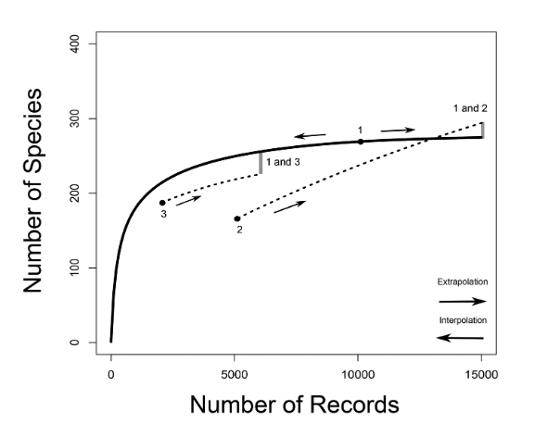
Figure 1. Species accumulation curves. Species richness is the asymptote of a species accumulation curve, which expresses the dependence on sampling effort of the number of species sampled from an assemblage. In CA2013, sampling effort is given by the number of records from which the number of species is calculated. For illustrative purposes, an example with three arbitrary samples (for 10000, 5000 and 2000 records, labeled from one to three) is drawn. For sample one, a predicted species accumulation curve is added that gradually increases from one species sampled to the predicted species richness for that assemblage (full line).
Such curves are constructed on the basis of interpolation and extrapolation. For samples two and three only segments of extrapolated curves are drawn (dotted lines). For sample two, a curve that crosses the species accumulation curve of sample one is sketched. For samples one and three species accumulation curves are more or less proportional. The way in which the species richness differences between samples are assessed in CA2013 is illustrated by indicating on the species accumulation curves at which numbers of records pairwise comparisons would be made between two sample pairs (1 vs. 2 and 1 vs. 3). The number of species of the sample with the smallest number of records is extrapolated to the number expected at three times the number of records. When the number of records of the other sample is still larger than that, the number of species of the second sample is interpolated (rarefied), otherwise it is extrapolated as well.

Slide 16
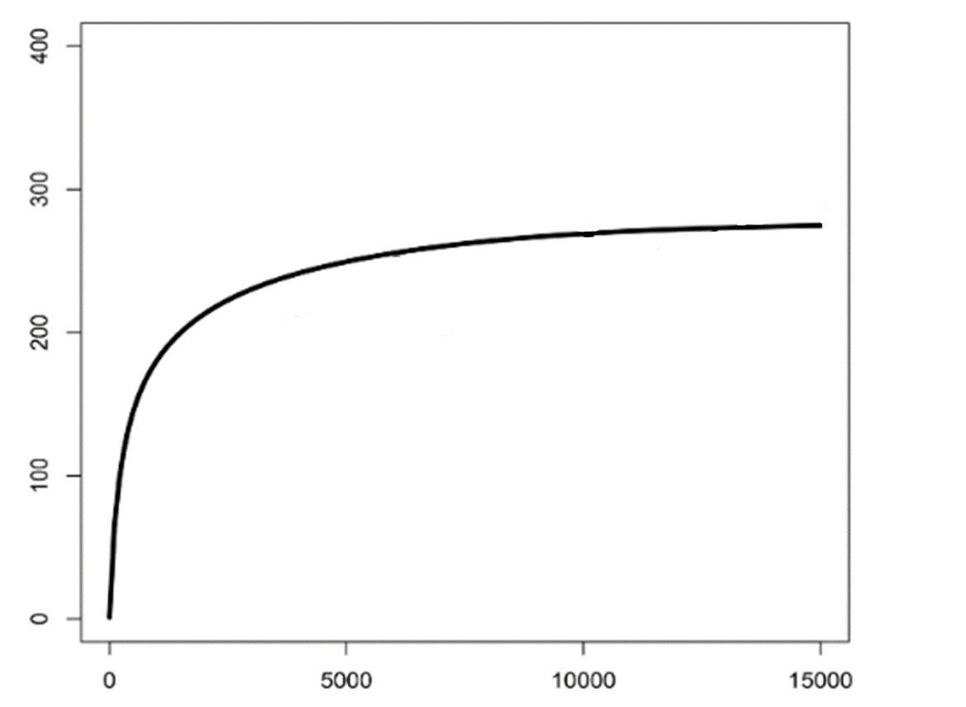
Can be thought of as a “rate” → # new species / time sampled
If this line completely flattens out, you’ve detected all of the species present
Cumulative number of species
Number of individuals caught

Slide 17
FIG_obj_state_var
Objectives
The specific objectives of each survey within a project, including
the Target Species,
the state variables (e.g., occupancy, density), and
proposed modelling approach(es).
Survey Objectives should be specific, measurable, achievable, relevant, and time-bound (i.e., SMART).
State variable
A formal measure that summarizes the state of a community or population at a particular time (Wearn & Glover-Kapfer, 2017)
For example
If the objective is “to monitor trends in wolf occupancy at 5-year intervals from January – December 2020 to 2023."
The state variable is "occupancy"

Slide 18
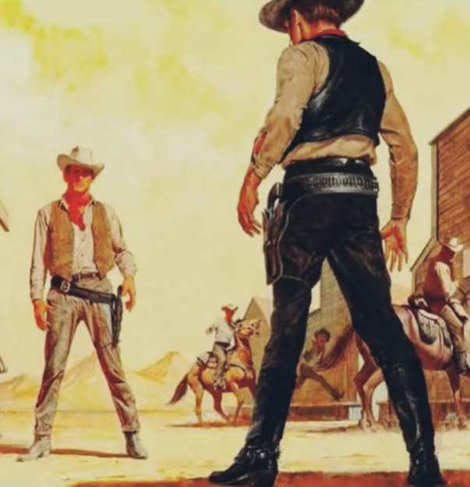
It’s the study design wild west out here

